Slide 1
Multithreading AND Asynchronous

Slide 2
Multitasking
Multitasking is the concept of running multiple application at a time.
Ex. Windows operating system is the multitasking operating system

Slide 3
Threading
Under the operating system, we have processes that running our applications.
Under the process, an application runs. To run the code of an application the process will make use of a concept called Thread.
Generally when we talk about thread, so Thread is a light weight process.
A process has at least one thread which is commonly called as main thread which actually executes the application code.
A single process can have multiple threads.
All the threading related classes are present in System.Threading namespace.

Slide 4
Thread Class
The Thread class helps us to perform tasks such as creating and setting the priority of a thread.
We can use this class to control a thread and obtain its status. The thread class provides various properties that allow us to perform tasks such as obtaining the status of a thread and specifying a name for the thread.
CurrentThread: It retrieves the thread which is currently running.
Alive: It retrieves a value to indicate the current state of thread execution. The value of the IsAlive property is true if the thread has been started or has been terminated, otherwise, the value is false.
Name: It specifies a name for a thread.
Priority: To obtain a value which indicates the scheduling priority of a thread. By default, the value of the Priority property is Normal. We can assign either Highest, AboveNormal, Normal, BelowNormal or Lowest value to the priority property.

Slide 5
Methods of the Thread Class
Interrupt(): To interrupt the thread which is in the Wait Sleep Join state.
Join(): is used to block all the calling threads until this thread terminates.
Resume(): To resume a thread which has been suspended earlier.
Sleep(): To block the current thread for a specified time period.
SpinWait(): To make a thread wait the number of times specified in the iteration parameter.
Start(): To start a thread
Suspend(): To suspend a thread.

Slide 6
Life Cycle of a thread
In C#, the thread life cycle specifies the current status of the thread. The thread automatically switches from one state to another state. At some times, you can switch its state by using the methods offered by Thread class.

Slide 7
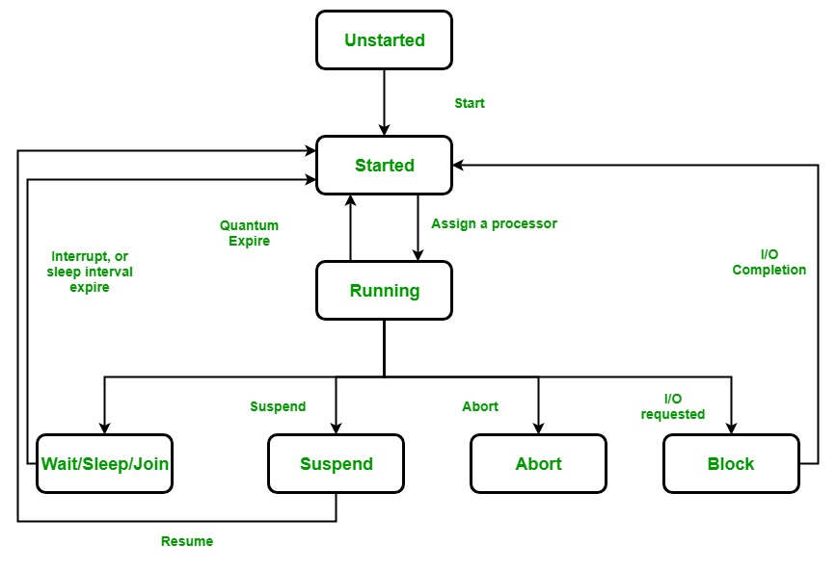

Slide 8
Unstarted state: When an instance of a Thread class is created, it is in the unstarted state, means the thread has not yet started to run when the thread is in this state. Or in other words Start() method is not called.
Eg Thread thr = new Thread();
Here, thr is at unstarted state.
Runnable State: A thread that is ready to run is moved to runnable state. In this state, a thread might actually be running or it might be ready to run at any instant of time. It is the responsibility of the thread scheduler to give the thread, time to run. Or in other words, the Start() method is called.
Running State: A thread that is running. Or in other words, the thread gets the processor.

Slide 9
Not Runnable State: A thread that is not executable because
Sleep() method is called.
Wait() method is called.
Due to I/O request.
Suspend() method is called.
Dead State: When the thread completes its task, then thread enters into dead, terminates, abort state.

Slide 10
Naming a thread and fetching name of current thread in C#
find the name of the current working thread by using the Thread.Name property of the Thread class.

Slide 11
Types of Threads in C#
Foreground Threads:
They prevent the application from terminating until all foreground threads have completed their tasks.
A foreground thread can be created by calling the Thread.Start() method.
By default all threads are Foreground threads
( ie their isBackground property is false)
Background Threads:
also created using the Thread class in C#
but they are considered to be the secondary threads of an application. They do not prevent the application from terminating, even if they are still running.
created by calling the Thread.Start() method and then setting the IsBackground property of the thread to true before starting it.

Slide 12
Foreground threads are useful when you need to perform a task that is critical to the operation of the application and must be completed before the application can terminate. For example, a foreground thread might be used to update the user interface or to perform important calculations.
Background threads are useful when you need to perform a task that is not critical to the operation of the application and can be terminated if the application needs to shut down. For example, a background thread might be used to download a large file or to perform periodic updates to a database.

Slide 13
Thread Priority
In a Multithreading environment, each thread has their own priority.
The by default priority of a thread is Normal.
Operating system does not assign the priority of threads.
If the value specified for a set operation is not a valid ThreadPriority value, then this will give ArgumentException
It is not guaranteed that the thread whose priority is high will executes first and the thread whose priority is low will executes after. Due to context switching the highest priority thread may execute after lowest priority thread.

Slide 14
How to set and get the priority of thread?
Thread.Priority Property is used to get or set a value indicating the scheduling priority of a thread.
Here, the ThreadPriority enum under System.Threading namespace
The priorities are:
Highest: The value of this priority is 4.
AboveNormal: The value of this priority is 3.
Normal: The value of this priority is 2.
BelowNormal: The value of this priority is 1.
Lowest: The value of this priority is 0.

Slide 15
LOCK
ensure that only one thread can access a specific section of code (called a critical section) at a time.
It prevents multiple threads from modifying shared data or resources concurrently, which could lead to race conditions or data corruption.
Syntax of lock
lock (object)
{
// Critical section (code that only one thread
can execute at a time)
}

Slide 16
WHAT IS SYNCHRONOUS IN C#
Synchronous programming is a programming model where operations take place sequentially
Asynchronous programming is a programming model
where operations does not dependent on each other.
Use async and await key word to achieve asynchronus
START
WHAT IS ASYNCHRONOUS IN C#
Function 1
Function 2
STOP

Slide 17
public class Demo
{
public async void method2()
{
await Task.Run(() => {
Console.WriteLine("method 2 start");
Thread.Sleep(5000);
Console.WriteLine("method 2 end");
});
}
public async void method4()
{
await Task.Run(() => {
Console.WriteLine("method 4 start");
Thread.Sleep(1000);
Console.WriteLine("method 4 end");
});
}
}

Slide 18
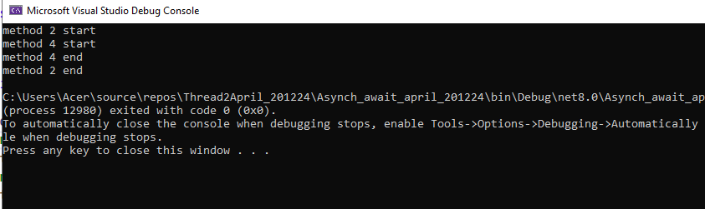
internal class Program
{
static void Main(string[] args)
{
Demo dd = new Demo();
dd.method2();// 5 sec
dd.method4();// 1 sec
Console.ReadKey();
}
}

